Slide 1




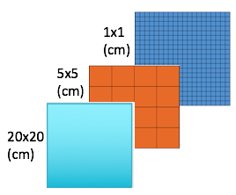
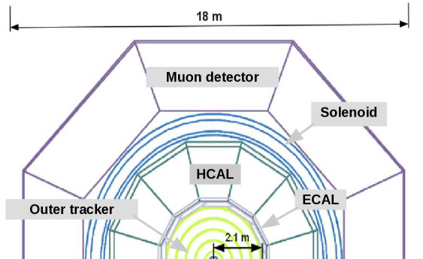
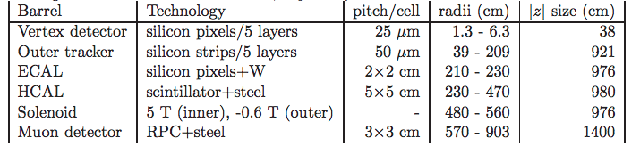
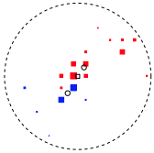
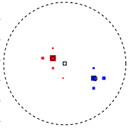

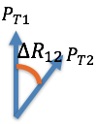
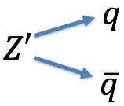
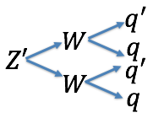
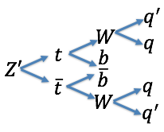
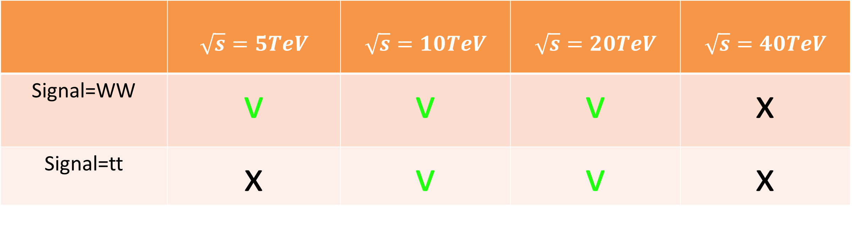

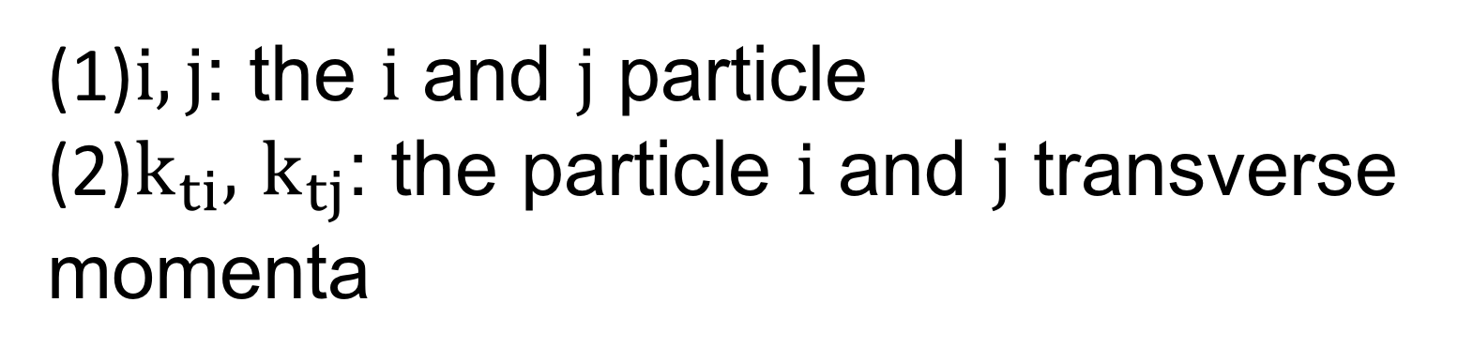
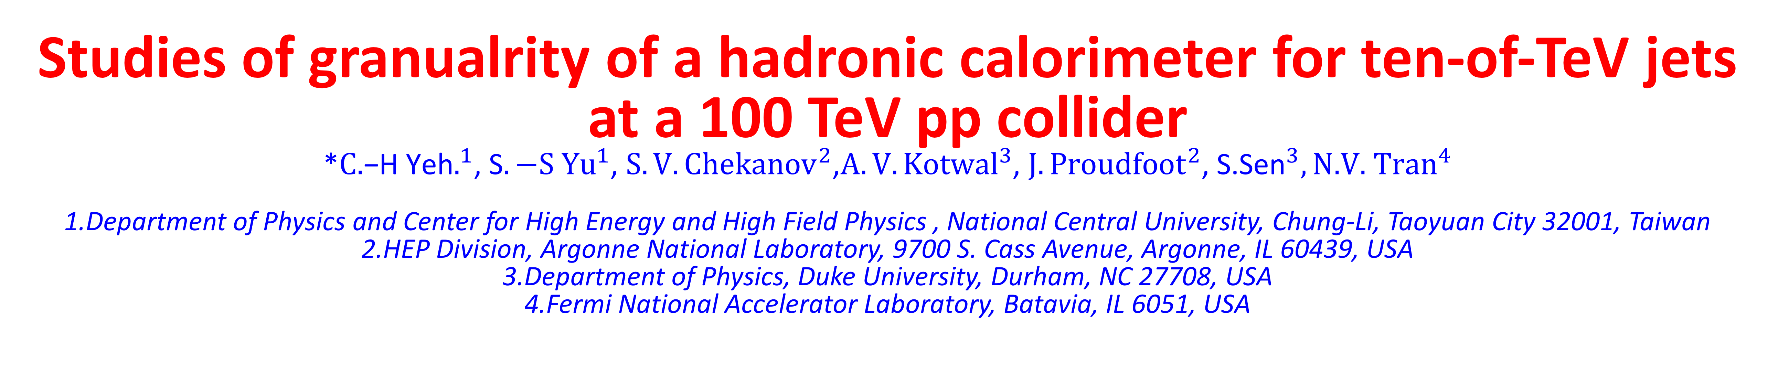


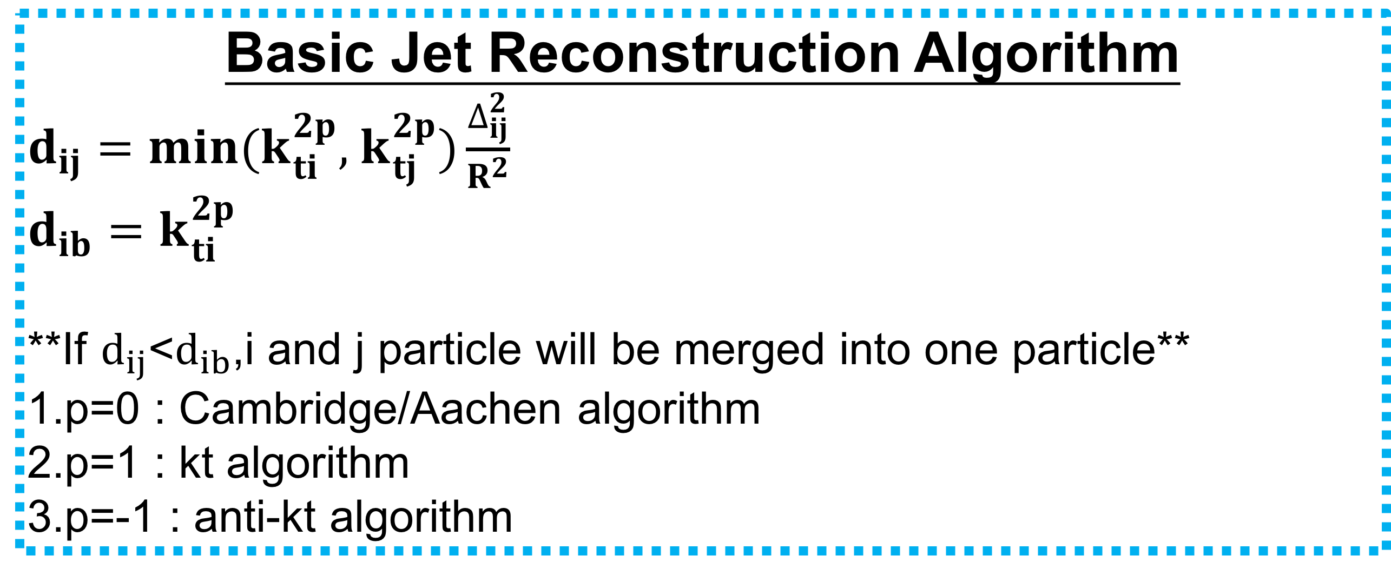

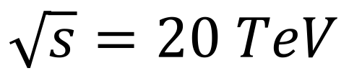
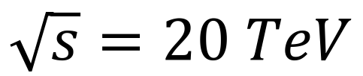
_{Ｄ}
Studies of granualrity of a hadronic calorimeter for ten-of-TeV jets at a 100 TeV pp collider
*${C\text{.}\text{−}\text{H} \text{Yeh}.}^{1}$, ${\text{S}.−S Yu}^{1}$, ${S.V. Chekanov}^{2}$,${A.V. Kotwal}^{3}$, ${J.Proudfoot}^{2}$,${ \text{S}\text{.}\text{Sen}}^{3},{\text{N}\text{.}\text{V}\text{. }\text{Tran}}^{4}$
1.Department of Physics and Center for High Energy and High Field Physics , National Central University, Chung-Li, Taoyuan City 32001, Taiwan
2.HEP Division, Argonne National Laboratory, 9700 S. Cass Avenue, Argonne, IL 60439, USA
3.Department of Physics, Duke University, Durham, NC 27708, USA 4.Fermi National Accelerator Laboratory, Batavia, IL 6051, USA
Abstract:
Jet substructure variables for hadronic jets with transverse momenta in the range from 2.5 TeV to 20 TeV were studied using several designs for the spacial size of calorimeter cells. The studies used the full Geant4 simulation of calorimeter response combined with realistic reconstruction of calorimeter clusters used in jet reconstruction. In most cases considered in this study, the results indicate that the performance of jet- substructure reconstruction improves with reducing cell sizes from 20 cm x 20 cm to 5 cm x 5 cm.
GEANT 4 Simulation of Future Detector
Results: Soft drop mass at $β=0$
HCAL cell sizes
$$\sqrt{s}=20 TeV$$
5x5(cm)
From[1]
*Conclusion*
Basic Jet Reconstruction Algorithm
$d_{ij}=min(k_{ti}^{2p},$ $k_{tj}^{2p})\frac{∆_{ij}^{2}}{R^{2}}$
$$d_{ib}=k_{ti}^{2p}$$
**If $d_{ij}$<$d_{ib}$,i and j particle will be merged into one particle**
1.p=0 : Cambridge/Aachen algorithm
2.p=1 : kt algorithm
3.p=-1 : anti-kt algorithm
Is the smallest detector cell size always the best?
Basic Jet Reconstruction Algorithm
 | $$\sqrt{s}=5TeV$$ | $$\sqrt{s}=10TeV$$ | $$\sqrt{s}=20TeV$$ | $$\sqrt{s}=40TeV$$
Signal=WW | v | v | v | x
Signal=tt | x | v | v | x
$$∆_{ij}^{2}=({y_{i}−y_{j})}^{2}+{(∅_{i}−∅_{j})}^{2}$$
(1)$i,j$: the $i$ and $j$ particle
(2)$k_{ti},$ $k_{tj}$: the particle $i$ and $j$ transverse momenta
Results: C and Tau variables
Jet Substructure Variables
$$C_{2}^{1}$$
$$\sqrt{s}=20 TeV$$
$$τ_{21}$$
Jet Substructure Variables
1.N-subjetness[2]:
$τ_{N}=\frac{1}{d_{0}}\sum_{k}{P_{t,k} min\{∆R_{1,k},∆R_{2,k}…∆R_{N,k}\}}$
${ d}_{0}=\sum_{k}{P_{t,k}R_{0}}$
$∆R_{i,k}:The distance between constuient in the eta−phi plane$
$R_{0}:The cone size we want to cluster$
$τ_{21}=\frac{τ_{2}}{τ_{1}},$ $τ_{32}=\frac{τ_{3}}{τ_{2}}$
2.Energy correlation function[3]:
$$ECF\left(N,β\right)=\sum_{i_{1}<i_{2}<..<i_{N}∈J}{(\prod_{a=1}^{N}{PT_{ia}){(\prod_{b=1}^{N−1}{\prod_{c=b+1}^{N}{∆R_{ibic}}})}^{β}}}$$
$C_{N}^{(β)}≡$ $\frac{ECF\left(N+1,β\right)ECF(N−1,β)}{{ECF(N,β)}^{2}}$
3.Soft drop[4]:
$$\frac{min(P_{T1,}P_{T2})}{P_{T1}+P_{T2}}<Z_{cut}{(\frac{∆R_{12}}{R_{0}})}^{β}$$
$$β>0:Remove both \left(soft )and (wide angle\right)$$
$$β=0:Depend on the cut to select the asymmetry$$
$$β<0:Remove both \left(soft\right)and (collinear)$$
5x5(cm)
*Conclusion*
Is the smallest detector cell size always the best?
In most cases, the best separation power is observed in the 5x5 cm cell size
Reference
[1]Initial performance studies of a general-purpose detector for multi-TeV physics at a 100 TeV pp collider, JINST 12 (2017) P06009
[2]Identifyling Booseted Objects with N-subjettiness, JHEP03(2011)015
[3]Energy correlation Functions for Jet Substrcture, JHEP06(2013)108
[4]Soft drop, JHEP05(2014)146
[5]Recursive soft drop, arxiv:1804.03657
Signal and Background Process
Background:
Signal:

